Slide 1
The Sleeping Barber Problem

Slide 2
The Sleeping Barber Problem
Another classical IPC problem takes place in a barber shop.
The barber shop has one barber, one barber chair, and n chairs for waiting customers, if any, to sit on.
If there are no customers present, the barber sits down in the barber chair and falls asleep.
When a customer arrives, he has to wake up the sleeping barber.
If additional customers arrive while the barber is cutting a customer's hair, they either sit down (if there are empty chairs) or leave the shop (if all chairs are full).

Slide 3
The Sleeping Barber Problem
The problem is to program the barber and the customers without getting into race conditions.
This problem is similar to various queuing situations, such as a multi person helpdesk with a computerized call waiting system for holding a limited number of incoming calls.

Slide 4
Solution
The solution uses three semaphores
customers, which counts waiting customers (excluding the customer in the barber chair, who is not waiting),
barbers, the number of barbers (0 or 1) who are idle, waiting for customers, and
mutex, which is used for mutual exclusion.
Solution uses a variable, waiting, which also counts the waiting customers.
The reason for having waiting is that there is no way to read the current value of a semaphore.

Slide 5
Barber Process
When the barber shows up for work in the morning, he executes the procedure barber, causing him to block on the semaphore customers because it is initially 0.
The barber then goes to sleep.
He stays asleep until the first customer shows up.

Slide 6
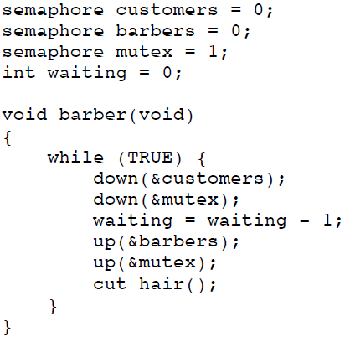
Barber Process

Slide 7
Customer Process
When a customer arrives, he executes customer, starting by acquiring mutex to enter a critical region.
If another customer enters shortly thereafter, the second one will no be able to do anything until the first one has released mutex.
The customer then checks to see if the number of waiting customers is less than the number of chairs.
If not, he releases mutex and leaves without a haircut.

Slide 8
Customer Process
If there is an available chair, the customer increments the integer variable, waiting.
Then he does an Up on the semaphore customers, thus waking up the barber.
At this point, the customer and the barber are both awake.
When the customer releases mutex, the barber grabs it, does some housekeeping, and begins the haircut.
When the haircut is over, the customer exits the procedure and leaves the shop.

Slide 9
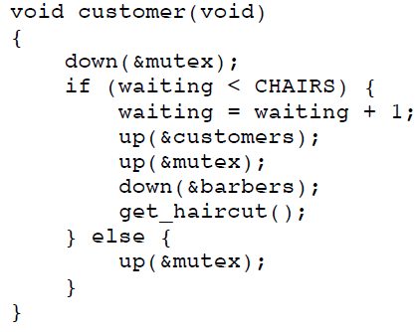
Customer Process

Slide 10
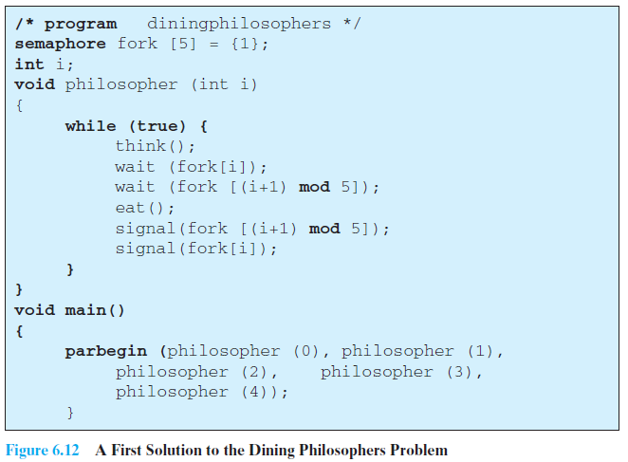
Assignment: Dining Philosophers' Problem

Slide 11
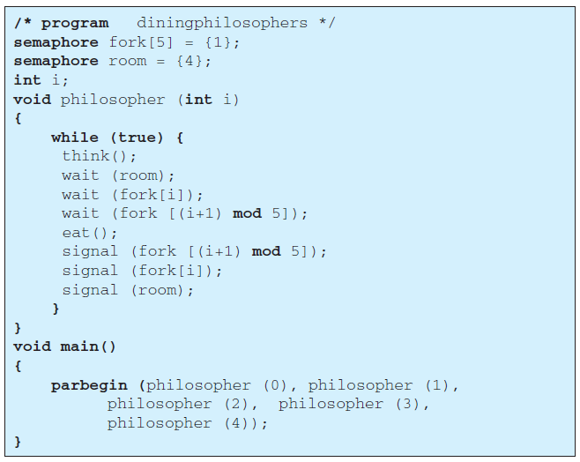
Assignment: Dining Philosophers' Problem

